Slide 1


Control Flow
Chris Piech
CS106A, Stanford University

Slide 2
Install Eclipse
Special Eclipse office hours
LAIR, Tonight 7-9pm
* Bottom floor of Tresidder

Slide 3
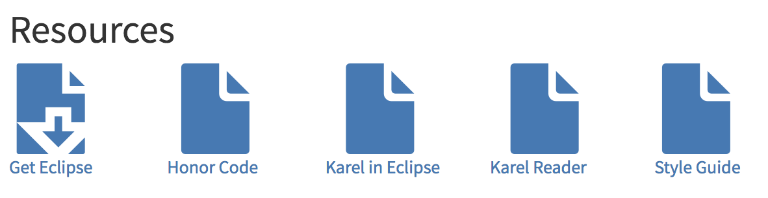
Assignment 1

Slide 4
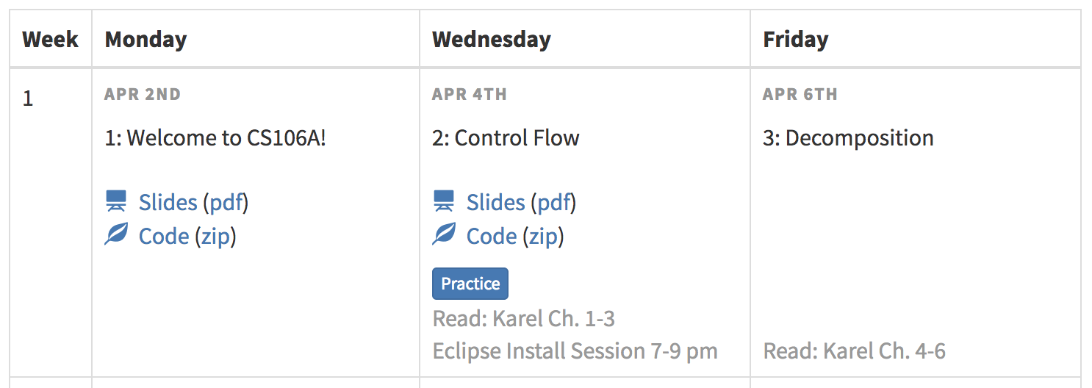
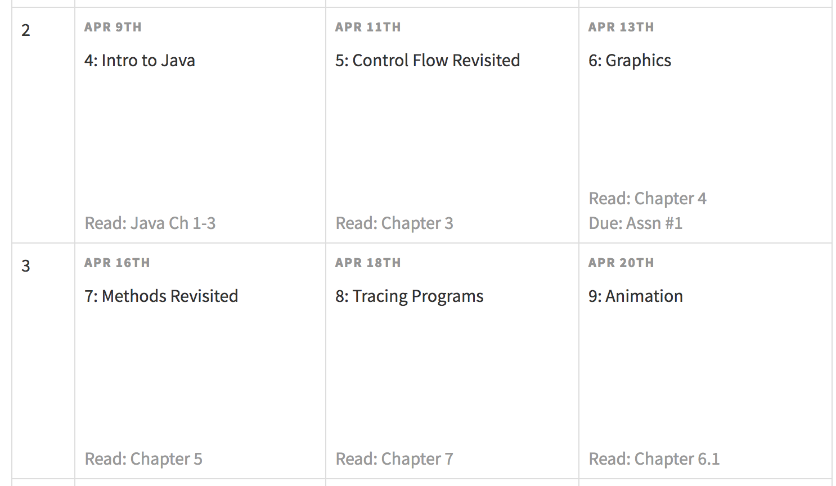
Today
Late Days
Assn due at 11am
Don’t accept submissions that are more than 1 week late
1 Late Day
2 Late Days

Slide 5
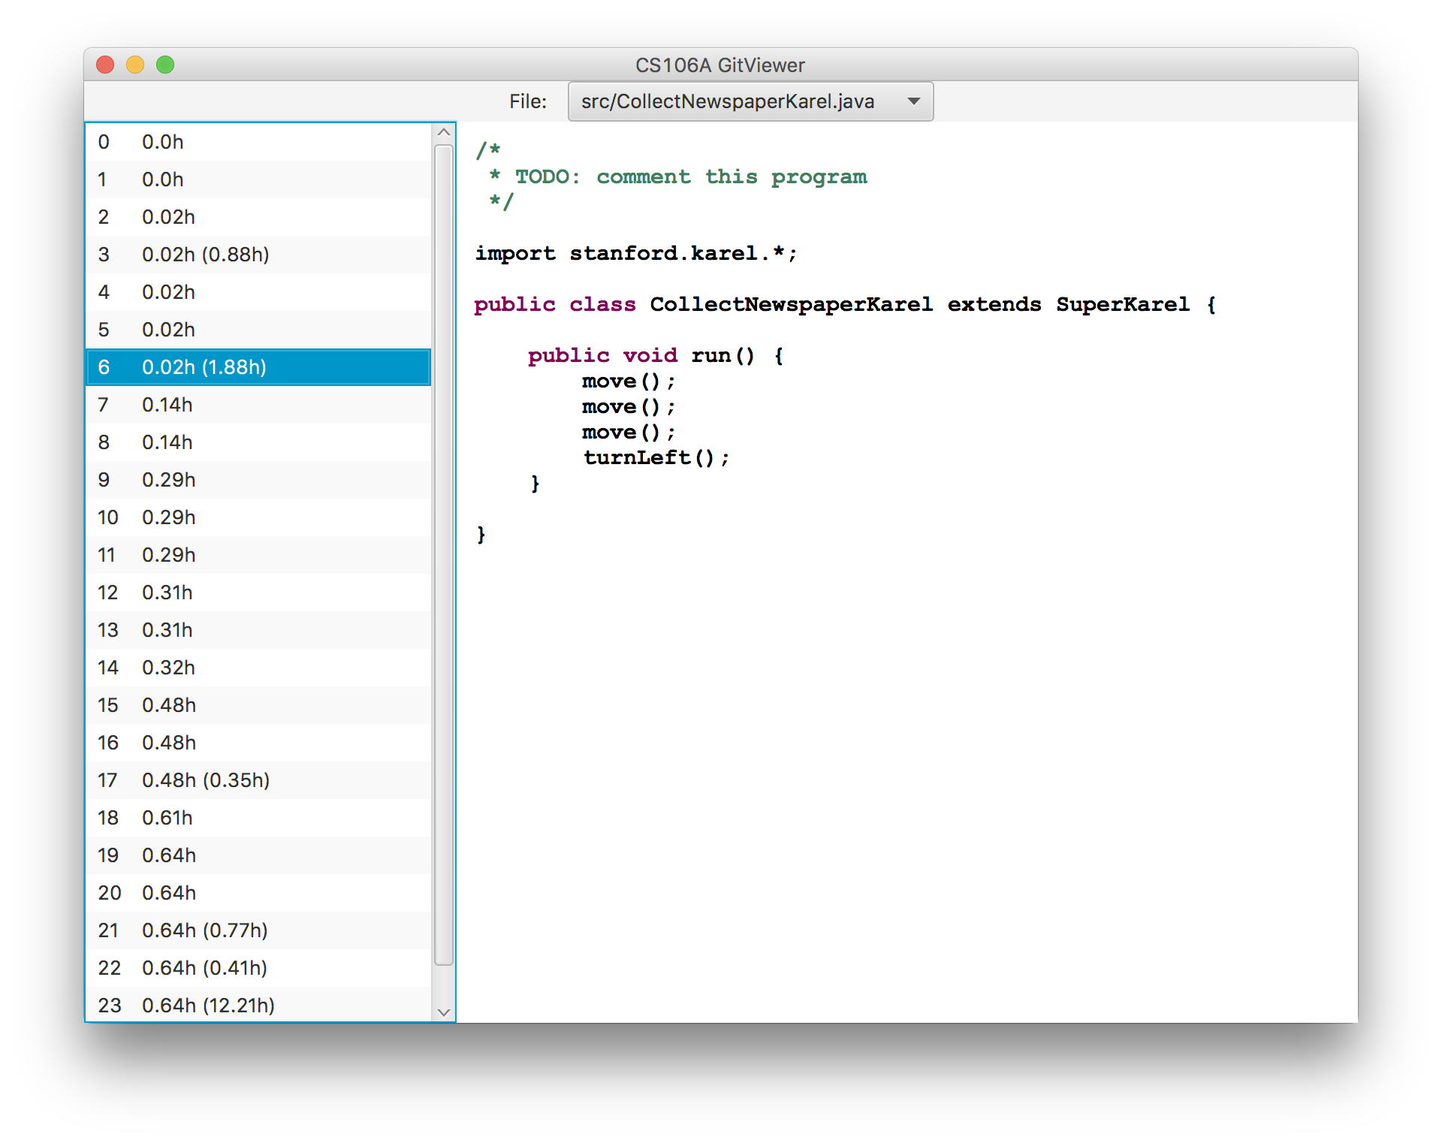
Feedback on Progress

Slide 6
Honor Code

Slide 7

CS106A

Slide 8


Karel the Robot
s
* While Karel is in Java, when you program your Karel assignment we ask that you stick to the concepts in the course reader
Notes:
Tomorrow you will learn that Karel is actually a very gentle introduction to programming

Slide 9


First Challenge
3
+
+
+
+
2
+
+
+
+
1
+
+
+
+
1
2
3
4

Slide 10
Anatomy of a Program
import stanford.karel.*;
public class OurKarelProgram extends Karel {
public void run() {
move();
pickBeeper();
move();
turnLeft();
move();
turnRight();
move();
putBeeper();
move();
}
private void turnRight() {
turnLeft();
turnLeft();
turnLeft();
}
}
This is the program's source code

Slide 11
Anatomy of a Program
import stanford.karel.*;
public class OurKarelProgram extends Karel {
public void run() {
move();
pickBeeper();
move();
turnLeft();
move();
turnRight();
move();
putBeeper();
move();
}
private void turnRight() {
turnLeft();
turnLeft();
turnLeft();
}
}
This piece of the program's source code is called a method.

Slide 12
Anatomy of a Program
import stanford.karel.*;
public class OurKarelProgram extends Karel {
public void run() {
move();
pickBeeper();
move();
turnLeft();
move();
turnRight();
move();
putBeeper();
move();
}
private void turnRight() {
turnLeft();
turnLeft();
turnLeft();
}
}
This line of code gives the name of the method
(here, turnRight)

Slide 13
Anatomy of a Program
import stanford.karel.*;
public class OurKarelProgram extends Karel {
public void run() {
move();
pickBeeper();
move();
turnLeft();
move();
turnRight();
move();
putBeeper();
move();
}
private void turnRight() {
turnLeft();
turnLeft();
turnLeft();
}
}
This is called a code block

Slide 14
Anatomy of a Program
import stanford.karel.*;
public class OurKarelProgram extends Karel {
public void run() {
move();
pickBeeper();
move();
turnLeft();
move();
turnRight();
move();
putBeeper();
move();
}
private void turnRight() {
turnLeft();
turnLeft();
turnLeft();
}
}

Slide 15
Anatomy of a Program
import stanford.karel.*;
public class OurKarelProgram extends Karel {
public void run() {
move();
pickBeeper();
move();
turnLeft();
move();
turnRight();
move();
putBeeper();
move();
}
private void turnRight() {
turnLeft();
turnLeft();
turnLeft();
}
}

Slide 16
Anatomy of a Program
import stanford.karel.*;
public class OurKarelProgram extends Karel {
public void run() {
move();
pickBeeper();
move();
turnLeft();
move();
turnRight();
move();
putBeeper();
move();
}
private void turnRight() {
turnLeft();
turnLeft();
turnLeft();
}
}

Slide 17
Anatomy of a Program
import stanford.karel.*;
public class OurKarelProgram extends Karel {
public void run() {
move();
pickBeeper();
move();
turnLeft();
move();
turnRight();
move();
putBeeper();
move();
}
private void turnRight() {
turnLeft();
turnLeft();
turnLeft();
}
}

Slide 18
Anatomy of a Program
import stanford.karel.*;
public class OurKarelProgram extends Karel {
public void run() {
move();
pickBeeper();
move();
turnLeft();
move();
turnRight();
move();
putBeeper();
move();
}
private void turnRight() {
turnLeft();
turnLeft();
turnLeft();
}
}
Methods are defined one after another

Slide 19

Method Definition
This adds a new command to Karels vocabulary
private void name() {
statements in the method body
}

Slide 20


Today’s Goal
Code using loops and conditions
Trace programs that use loops and conditions

Slide 21


Today’s Route
You are here
Control
Flow
If/Else
If
While
Loops
For
Loops
The River of Control Flow

Slide 22
For loops,
While loops,
If/Else statements

Slide 23
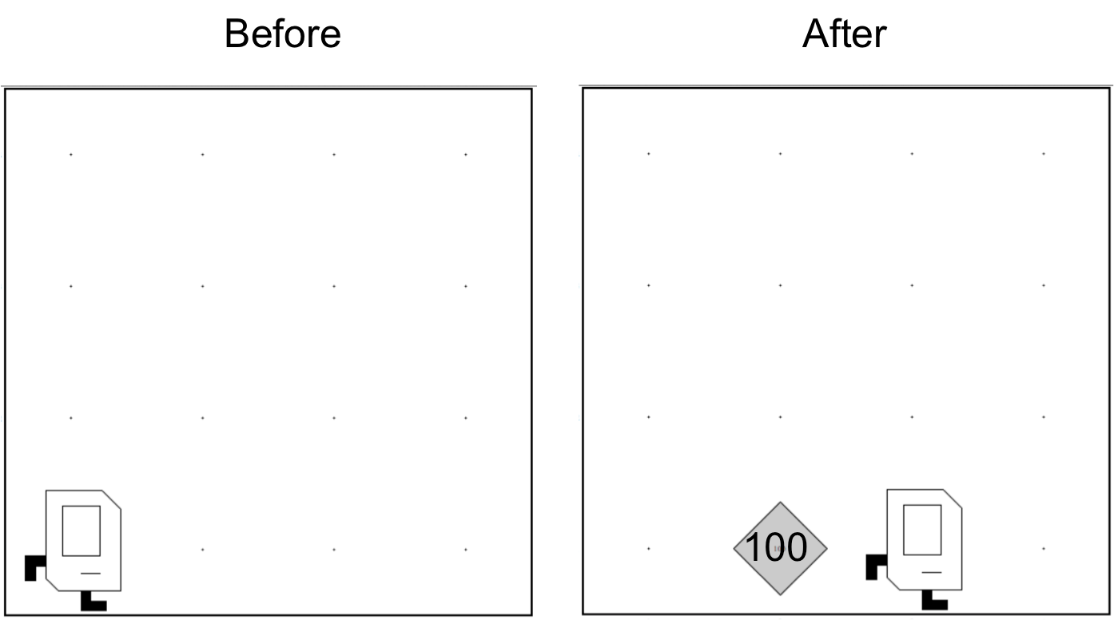
Place 99 beepers?
99

Slide 24
Place 99 beepers
public class Place99Beepers extends SuperKarel {
public void run() {
move();
repeat(99) {
putBeeper();
}
move();
}
}

Slide 25
Place 99 beepers
public class Place99Beepers extends SuperKarel {
public void run() {
move();
for(int i = 0; i < 99; i++) {
putBeeper();
}
move();
}
}
This “for loop” repeats the code in its “body” 99 times

Slide 26

Place Beeper Square
public class BeeperSquare extends SuperKarel {
public void run() {
for(int i = 0; i < 4; i++) {
putBeeper();
move();
turnLeft();
}
}
}

Slide 27
Place Beeper Square
public class BeeperSquare extends SuperKarel {
public void run() {
for(int i = 0; i < 4; i++) {
putBeeper();
move();
turnLeft();
}
}
}

Slide 28
Place Beeper Square
public class BeeperSquare extends SuperKarel {
public void run() {
for(int i = 0; i < 4; i++) {
putBeeper();
move();
turnLeft();
}
}
}
First time through the loop

Slide 29

Place Beeper Square
public class BeeperSquare extends SuperKarel {
public void run() {
for(int i = 0; i < 4; i++) {
putBeeper();
move();
turnLeft();
}
}
}
First time through the loop

Slide 30
Place Beeper Square
public class BeeperSquare extends SuperKarel {
public void run() {
for(int i = 0; i < 4; i++) {
putBeeper();
move();
turnLeft();
}
}
}
First time through the loop

Slide 31
Place Beeper Square
public class BeeperSquare extends SuperKarel {
public void run() {
for(int i = 0; i < 4; i++) {
putBeeper();
move();
turnLeft();
}
}
}
First time through the loop

Slide 32
Place Beeper Square
public class BeeperSquare extends SuperKarel {
public void run() {
for(int i = 0; i < 4; i++) {
putBeeper();
move();
turnLeft();
}
}
}
Second time through the loop

Slide 33
Place Beeper Square
public class BeeperSquare extends SuperKarel {
public void run() {
for(int i = 0; i < 4; i++) {
putBeeper();
move();
turnLeft();
}
}
}
Second time through the loop

Slide 34
Place Beeper Square
public class BeeperSquare extends SuperKarel {
public void run() {
for(int i = 0; i < 4; i++) {
putBeeper();
move();
turnLeft();
}
}
}
Second time through the loop

Slide 35
Place Beeper Square
public class BeeperSquare extends SuperKarel {
public void run() {
for(int i = 0; i < 4; i++) {
putBeeper();
move();
turnLeft();
}
}
}
Second time through the loop

Slide 36
Place Beeper Square
public class BeeperSquare extends SuperKarel {
public void run() {
for(int i = 0; i < 4; i++) {
putBeeper();
move();
turnLeft();
}
}
}
Third time through the loop

Slide 37
Place Beeper Square
public class BeeperSquare extends SuperKarel {
public void run() {
for(int i = 0; i < 4; i++) {
putBeeper();
move();
turnLeft();
}
}
}
Third time through the loop

Slide 38
Place Beeper Square
public class BeeperSquare extends SuperKarel {
public void run() {
for(int i = 0; i < 4; i++) {
putBeeper();
move();
turnLeft();
}
}
}
Third time through the loop

Slide 39
Place Beeper Square
public class BeeperSquare extends SuperKarel {
public void run() {
for(int i = 0; i < 4; i++) {
putBeeper();
move();
turnLeft();
}
}
}
Third time through the loop

Slide 40
Place Beeper Square
public class BeeperSquare extends SuperKarel {
public void run() {
for(int i = 0; i < 4; i++) {
putBeeper();
move();
turnLeft();
}
}
}
Fourth time through the loop

Slide 41
Place Beeper Square
public class BeeperSquare extends SuperKarel {
public void run() {
for(int i = 0; i < 4; i++) {
putBeeper();
move();
turnLeft();
}
}
}
Fourth time through the loop

Slide 42
Place Beeper Square
public class BeeperSquare extends SuperKarel {
public void run() {
for(int i = 0; i < 4; i++) {
putBeeper();
move();
turnLeft();
}
}
}
Fourth time through the loop

Slide 43
Place Beeper Square
public class BeeperSquare extends SuperKarel {
public void run() {
for(int i = 0; i < 4; i++) {
putBeeper();
move();
turnLeft();
}
}
}
Fourth time through the loop

Slide 44
Place Beeper Square
public class BeeperSquare extends SuperKarel {
public void run() {
for(int i = 0; i < 4; i++) {
putBeeper();
move();
turnLeft();
}
}
}
Fourth time through the loop

Slide 45
Place Beeper Square
public class BeeperSquare extends SuperKarel {
public void run() {
for(int i = 0; i < 4; i++) {
putBeeper();
move();
turnLeft();
}
}
}

Slide 46
Exciting!

Slide 47

Aside: Super Karel
public class BeeperSquare extends SuperKarel {
public void run() {
for(int i = 0; i < 4; i++) {
putBeeper();
move();
turnLeft();
}
}
}

Slide 48
Aside: Super Karel
public class BeeperSquare extends SuperKarel {
public void run() {
// super karel has a few more commands
turnRight();
turnAround();
paintCorner(BLUE);
putBeeper();
move();
}
}

Slide 49
Next task

Slide 50
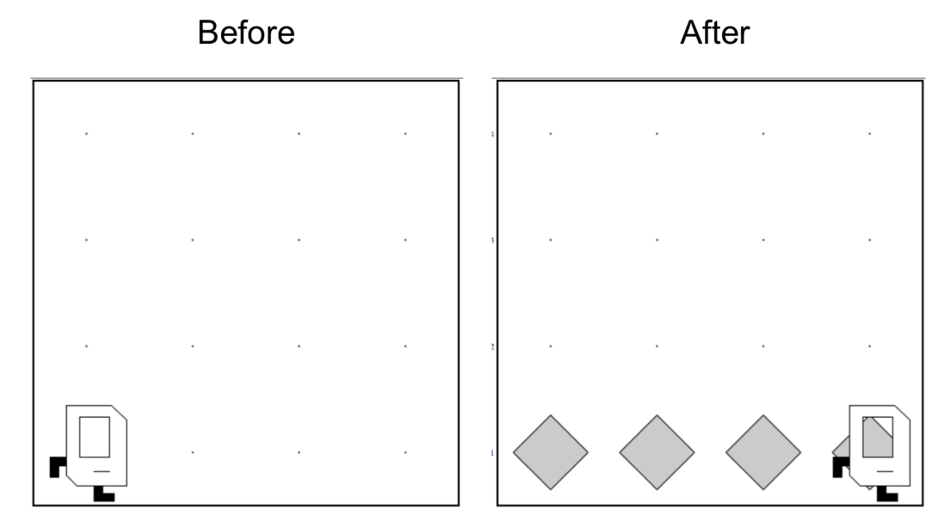
Place Beeper Line
Try and solve it!

Slide 51
Place Beeper Line
import stanford.karel.*;
public class BeeperLine extends SuperKarel {
public void run() {
for(int i = 0; i < 4; i++) {
putBeeper();
move();
}
}
}

Slide 52


Slide 53


Place Beeper Line
import stanford.karel.*;
public class BeeperLine extends SuperKarel {
public void run() {
for(int i = 0; i < 4; i++) {
putBeeper();
move();
}
}
}

Slide 54
Place Beeper Line
import stanford.karel.*;
public class BeeperLine extends SuperKarel {
public void run() {
for(int i = 0; i < 4; i++) {
putBeeper();
move();
}
}
}

Slide 55
Place Beeper Line
import stanford.karel.*;
public class BeeperLine extends SuperKarel {
public void run() {
for(int i = 0; i < 4; i++) {
putBeeper();
move();
}
}
}

Slide 56
Place Beeper Line
import stanford.karel.*;
public class BeeperLine extends SuperKarel {
public void run() {
for(int i = 0; i < 4; i++) {
putBeeper();
move();
}
}
}
1st time through loop

Slide 57
Place Beeper Line
import stanford.karel.*;
public class BeeperLine extends SuperKarel {
public void run() {
for(int i = 0; i < 4; i++) {
putBeeper();
move();
}
}
}
1st time through loop

Slide 58
Place Beeper Line
import stanford.karel.*;
public class BeeperLine extends SuperKarel {
public void run() {
for(int i = 0; i < 4; i++) {
putBeeper();
move();
}
}
}
1st time through loop

Slide 59
Place Beeper Line
import stanford.karel.*;
public class BeeperLine extends SuperKarel {
public void run() {
for(int i = 0; i < 4; i++) {
putBeeper();
move();
}
}
}
2nd time through loop

Slide 60
Place Beeper Line
import stanford.karel.*;
public class BeeperLine extends SuperKarel {
public void run() {
for(int i = 0; i < 4; i++) {
putBeeper();
move();
}
}
}
2nd time through loop

Slide 61
Place Beeper Line
import stanford.karel.*;
public class BeeperLine extends SuperKarel {
public void run() {
for(int i = 0; i < 4; i++) {
putBeeper();
move();
}
}
}
2nd time through loop

Slide 62
Place Beeper Line
import stanford.karel.*;
public class BeeperLine extends SuperKarel {
public void run() {
for(int i = 0; i < 4; i++) {
putBeeper();
move();
}
}
}
2nd time through loop

Slide 63
Place Beeper Line
import stanford.karel.*;
public class BeeperLine extends SuperKarel {
public void run() {
for(int i = 0; i < 4; i++) {
putBeeper();
move();
}
}
}
3rd time through loop

Slide 64
Place Beeper Line
import stanford.karel.*;
public class BeeperLine extends SuperKarel {
public void run() {
for(int i = 0; i < 4; i++) {
putBeeper();
move();
}
}
}
3rd time through loop

Slide 65
Place Beeper Line
import stanford.karel.*;
public class BeeperLine extends SuperKarel {
public void run() {
for(int i = 0; i < 4; i++) {
putBeeper();
move();
}
}
}
3rd time through loop

Slide 66
Place Beeper Line
import stanford.karel.*;
public class BeeperLine extends SuperKarel {
public void run() {
for(int i = 0; i < 4; i++) {
putBeeper();
move();
}
}
}
4th time through loop

Slide 67
Place Beeper Line
import stanford.karel.*;
public class BeeperLine extends SuperKarel {
public void run() {
for(int i = 0; i < 4; i++) {
putBeeper();
move();
}
}
}
4th time through loop

Slide 68
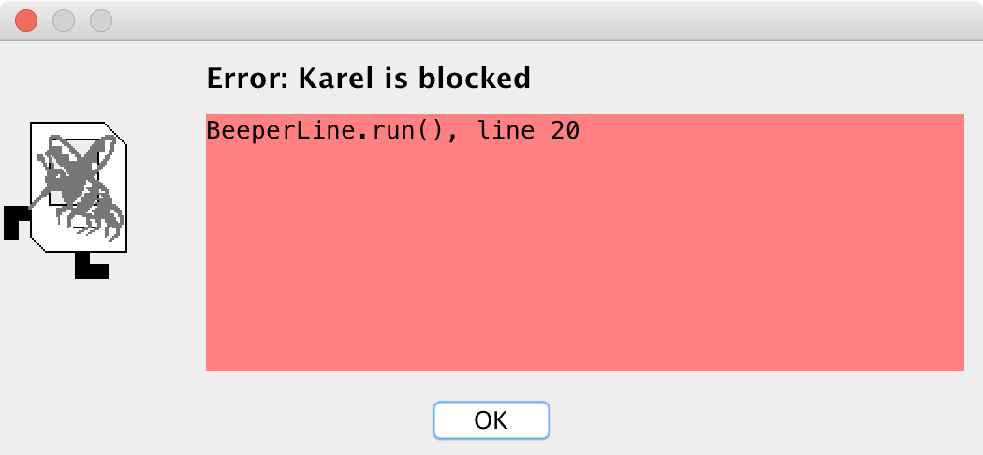
Place Beeper Line
import stanford.karel.*;
public class BeeperLine extends SuperKarel {
public void run() {
for(int i = 0; i < 4; i++) {
putBeeper();
move();
}
}
}
4th time through loop

Slide 69

Place Beeper Line
import stanford.karel.*;
public class BeeperLine extends SuperKarel {
public void run() {
for(int i = 0; i < 4; i++) {
putBeeper();
move();
}
}
}
What we want

Slide 70
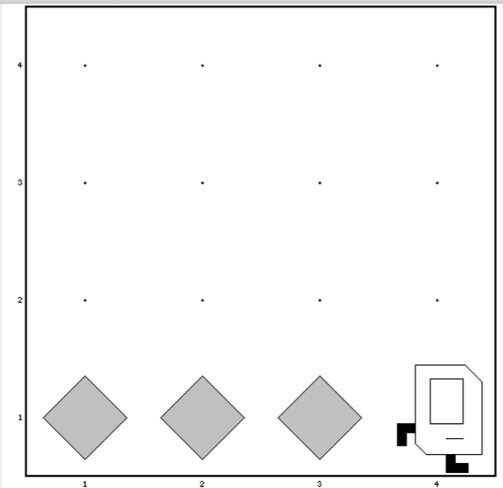
Place Beeper Line
import stanford.karel.*;
public class BeeperLine extends SuperKarel {
public void run() {
for(int i = 0; i < 3; i++) {
putBeeper();
move();
}
}
}

Slide 71

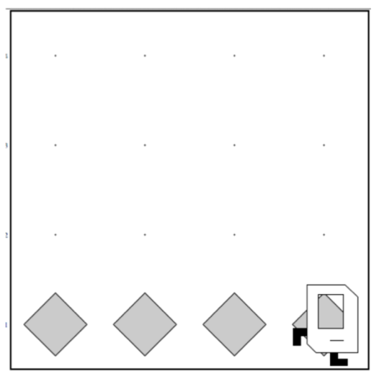
Place Beeper Line
import stanford.karel.*;
public class BeeperLine extends SuperKarel {
public void run() {
for(int i = 0; i < 3; i++) {
putBeeper();
move();
}
// extra put beeper
putBeeper();
}
}

Slide 72
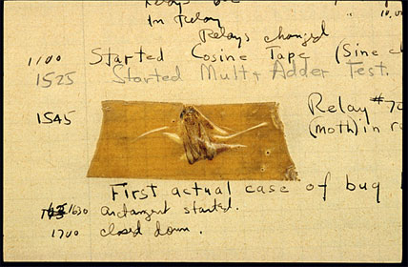
Actual Bug from Mark II Computer
Actual Bug from Marc II
Notes:
Grace Hopper

Slide 73
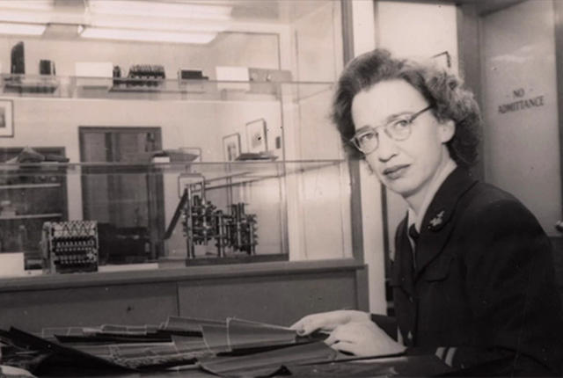
Grace Hopper

Slide 74
Place Beeper Line
import stanford.karel.*;
public class BeeperLine extends SuperKarel {
public void run() {
for(int i = 0; i < 3; i++) {
putBeeper();
move();
}
// extra put beeper
putBeeper();
}
}

Slide 75
Fence Post Problem
* Also sometimes called an Off By One Error

Slide 76
Unstoppable

Slide 77
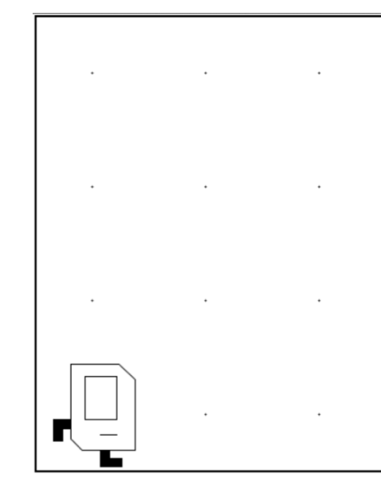
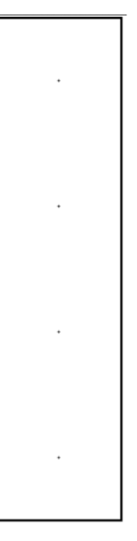
Don’t Know World Size
?

Slide 78
While Loop

Slide 79
While Loop
import stanford.karel.*;
public class BeeperLine extends SuperKarel {
public void run() {
// example while loop
while(condition) {
code to repeat
}
}
}

Slide 80
Possible Conditions
Test | Opposite | What it checks
frontIsClear() | frontIsBlocked() | Is there a wall in front of Karel?
leftIsClear() | leftIsBlocked() | Is there a wall to Karel’s left?
rightIsClear() | rightIsBlocked() | Is there a wall to Karel’s right?
beepersPresent() | noBeepersPresent() | Are there beepers on this corner?
beepersInBag() | noBeepersInBag() | Any there beepers in Karel’s bag?
facingNorth() | notFacingNorth() | Is Karel facing north?
facingEast() | notFacingEast() | Is Karel facing east?
facingSouth() | notFacingSouth() | Is Karel facing south?
facingWest() | notFacingWest() | Is Karel facing west?
This is Table 1 on page 18 of the Karel coursereader.

Slide 81
Move to Wall
import stanford.karel.*;
public class BeeperLine extends SuperKarel {
public void run() {
// example while loop
while(condition) {
code to repeat
}
}
}

Slide 82
Move to Wall
import stanford.karel.*;
public class BeeperLine extends SuperKarel {
public void run() {
// example while loop
while(frontIsClear()) {
code to repeat
}
}
}

Slide 83
Move to Wall
import stanford.karel.*;
public class BeeperLine extends SuperKarel {
public void run() {
// example while loop
while(frontIsClear()) {
move();
}
}
}

Slide 84
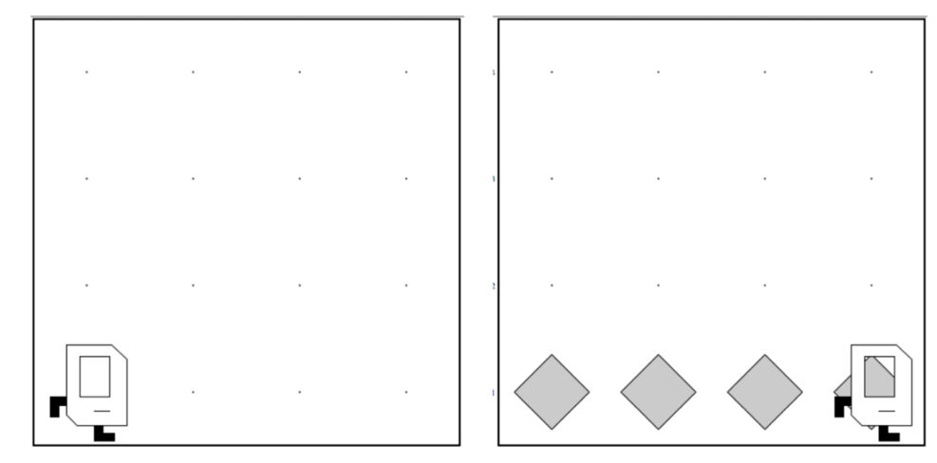
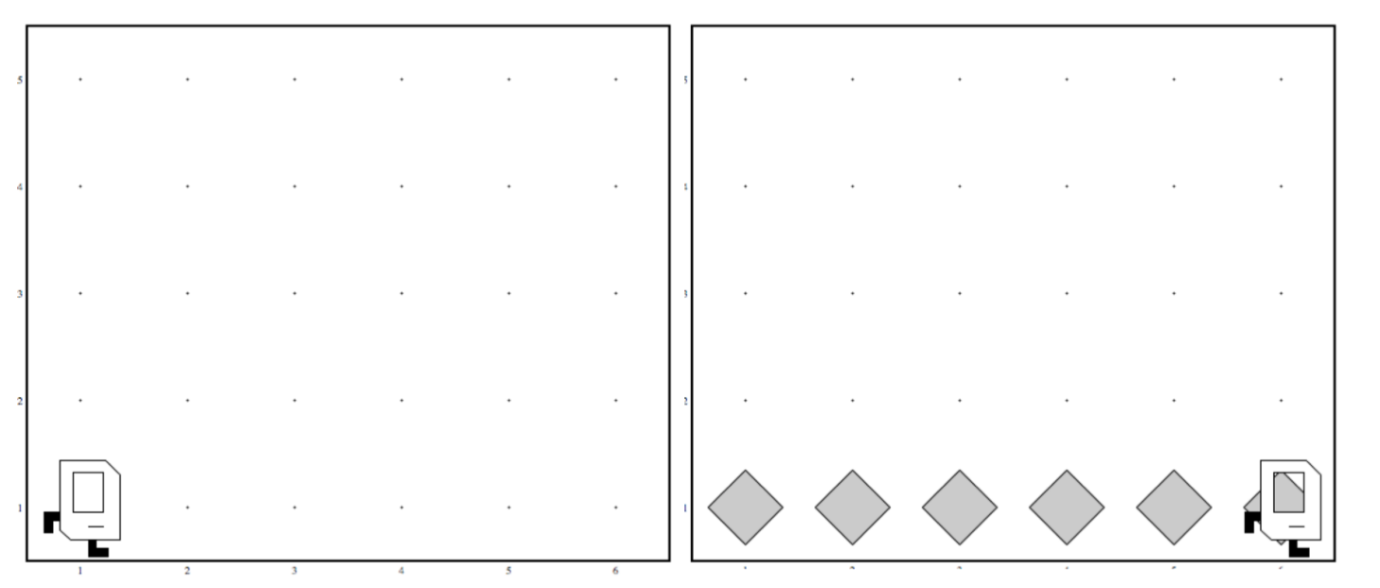
Code that Works in Any World
Before
After
Before
After

Slide 85
Place Beeper Line
import stanford.karel.*;
public class BeeperLine extends SuperKarel {
public void run() {
// example while loop
while(frontIsClear()) {
move();
}
}
}

Slide 86
Place Beeper Line
import stanford.karel.*;
public class BeeperLine extends SuperKarel {
public void run() {
// example while loop
while(frontIsClear()) {
putBeeper();
move();
}
}
}

Slide 87
Place Beeper Line
import stanford.karel.*;
public class BeeperLine extends SuperKarel {
public void run() {
// example while loop
while(frontIsClear()) {
putBeeper();
move();
}
}
}

Slide 88
Place Beeper Line
import stanford.karel.*;
public class BeeperLine extends SuperKarel {
public void run() {
// example while loop
while(frontIsClear()) {
putBeeper();
move();
}
}
}

Slide 89
Place Beeper Line
import stanford.karel.*;
public class BeeperLine extends SuperKarel {
public void run() {
// example while loop
while(frontIsClear()) {
putBeeper();
move();
}
}
}

Slide 90
Place Beeper Line
import stanford.karel.*;
public class BeeperLine extends SuperKarel {
public void run() {
// example while loop
while(frontIsClear()) {
putBeeper();
move();
}
}
}

Slide 91
Place Beeper Line
import stanford.karel.*;
public class BeeperLine extends SuperKarel {
public void run() {
// example while loop
while(frontIsClear()) {
putBeeper();
move();
}
}
}

Slide 92
Place Beeper Line
import stanford.karel.*;
public class BeeperLine extends SuperKarel {
public void run() {
// example while loop
while(frontIsClear()) {
putBeeper();
move();
}
}
}

Slide 93
Place Beeper Line
import stanford.karel.*;
public class BeeperLine extends SuperKarel {
public void run() {
// example while loop
while(frontIsClear()) {
putBeeper();
move();
}
}
}

Slide 94
Place Beeper Line
import stanford.karel.*;
public class BeeperLine extends SuperKarel {
public void run() {
// example while loop
while(frontIsClear()) {
putBeeper();
move();
}
}
}

Slide 95
Place Beeper Line
import stanford.karel.*;
public class BeeperLine extends SuperKarel {
public void run() {
// example while loop
while(frontIsClear()) {
putBeeper();
move();
}
}
}

Slide 96
Place Beeper Line
import stanford.karel.*;
public class BeeperLine extends SuperKarel {
public void run() {
// example while loop
while(frontIsClear()) {
putBeeper();
move();
}
}
}

Slide 97
Place Beeper Line
import stanford.karel.*;
public class BeeperLine extends SuperKarel {
public void run() {
// example while loop
while(frontIsClear()) {
putBeeper();
move();
}
}
}

Slide 98
Place Beeper Line
import stanford.karel.*;
public class BeeperLine extends SuperKarel {
public void run() {
// example while loop
while(frontIsClear()) {
putBeeper();
move();
}
}
}

Slide 99
Place Beeper Line
import stanford.karel.*;
public class BeeperLine extends SuperKarel {
public void run() {
// example while loop
while(frontIsClear()) {
putBeeper();
move();
}
}
}

Slide 100
Place Beeper Line
import stanford.karel.*;
public class BeeperLine extends SuperKarel {
public void run() {
// example while loop
while(frontIsClear()) {
putBeeper();
move();
}
}
}

Slide 101
Place Beeper Line
import stanford.karel.*;
public class BeeperLine extends SuperKarel {
public void run() {
// example while loop
while(frontIsClear()) {
putBeeper();
move();
}
}
}

Slide 102
Place Beeper Line
import stanford.karel.*;
public class BeeperLine extends SuperKarel {
public void run() {
// example while loop
while(frontIsClear()) {
putBeeper();
move();
}
// extra put beeper
putBeeper();
}
}

Slide 103
Place Beeper Line
import stanford.karel.*;
public class BeeperLine extends SuperKarel {
public void run() {
// example while loop
while(frontIsClear()) {
putBeeper();
move();
}
// extra put beeper
putBeeper();
}
}

Slide 104
Place Beeper Line
import stanford.karel.*;
public class BeeperLine extends SuperKarel {
public void run() {
// example while loop
while(frontIsClear()) {
putBeeper();
move();
}
// extra put beeper
putBeeper();
}
}

Slide 105
Place Beeper Line
import stanford.karel.*;
public class BeeperLine extends SuperKarel {
public void run() {
// example while loop
while(frontIsClear()) {
putBeeper();
move();
}
// extra put beeper
putBeeper();
}
}

Slide 106
Place Beeper Line
import stanford.karel.*;
public class BeeperLine extends SuperKarel {
public void run() {
// example while loop
while(frontIsClear()) {
putBeeper();
move();
}
// extra put beeper
putBeeper();
}
}

Slide 107
Place Beeper Line
import stanford.karel.*;
public class BeeperLine extends SuperKarel {
public void run() {
// example while loop
while(frontIsClear()) {
putBeeper();
move();
}
// extra put beeper
putBeeper();
}
}

Slide 108
Place Beeper Line
import stanford.karel.*;
public class BeeperLine extends SuperKarel {
public void run() {
// example while loop
while(frontIsClear()) {
putBeeper();
move();
}
// extra put beeper
putBeeper();
}
}

Slide 109
Place Beeper Line
import stanford.karel.*;
public class BeeperLine extends SuperKarel {
public void run() {
// example while loop
while(frontIsClear()) {
putBeeper();
move();
}
// extra put beeper
putBeeper();
}
}

Slide 110
Place Beeper Line
import stanford.karel.*;
public class BeeperLine extends SuperKarel {
public void run() {
// example while loop
while(frontIsClear()) {
putBeeper();
move();
}
// extra put beeper
putBeeper();
}
}

Slide 111
Place Beeper Line
import stanford.karel.*;
public class BeeperLine extends SuperKarel {
public void run() {
// example while loop
while(frontIsClear()) {
putBeeper();
move();
}
// extra put beeper
putBeeper();
}
}

Slide 112
Place Beeper Line
import stanford.karel.*;
public class BeeperLine extends SuperKarel {
public void run() {
// example while loop
while(frontIsClear()) {
putBeeper();
move();
}
// extra put beeper
putBeeper();
}
}

Slide 113
Place Beeper Line
import stanford.karel.*;
public class BeeperLine extends SuperKarel {
public void run() {
// example while loop
while(frontIsClear()) {
putBeeper();
move();
}
// extra put beeper
putBeeper();
}
}

Slide 114
Place Beeper Line
import stanford.karel.*;
public class BeeperLine extends SuperKarel {
public void run() {
// example while loop
while(frontIsClear()) {
putBeeper();
move();
}
// extra put beeper
putBeeper();
}
}

Slide 115
Place Beeper Line
import stanford.karel.*;
public class BeeperLine extends SuperKarel {
public void run() {
// example while loop
while(frontIsClear()) {
putBeeper();
move();
}
// extra put beeper
putBeeper();
}
}

Slide 116
Place Beeper Line
import stanford.karel.*;
public class BeeperLine extends SuperKarel {
public void run() {
// example while loop
while(frontIsClear()) {
putBeeper();
move();
}
// extra put beeper
putBeeper();
}
}

Slide 117
Place Beeper Line
import stanford.karel.*;
public class BeeperLine extends SuperKarel {
public void run() {
// example while loop
while(frontIsClear()) {
putBeeper();
move();
}
// extra put beeper
putBeeper();
}
}

Slide 119
Common misconception:

Slide 120
Place Beeper Line: Redux
import stanford.karel.*;
public class BeeperLine extends SuperKarel {
public void run() {
// place a first beeper
putBeeper();
// example while loop
while(frontIsClear()) {
move();
putBeeper();
}
}
}

Slide 121
Place Beeper Line: Redux
import stanford.karel.*;
public class BeeperLine extends SuperKarel {
public void run() {
// place a first beeper
putBeeper();
// example while loop
while(frontIsClear()) {
move();
putBeeper();
}
}
}

Slide 122
Place Beeper Line: Redux
import stanford.karel.*;
public class BeeperLine extends SuperKarel {
public void run() {
// place a first beeper
putBeeper();
// example while loop
while(frontIsClear()) {
move();
putBeeper();
}
}
}

Slide 123
Place Beeper Line: Redux
import stanford.karel.*;
public class BeeperLine extends SuperKarel {
public void run() {
// place a first beeper
putBeeper();
// example while loop
while(frontIsClear()) {
move();
putBeeper();
}
}
}

Slide 124
Place Beeper Line: Redux
import stanford.karel.*;
public class BeeperLine extends SuperKarel {
public void run() {
// place a first beeper
putBeeper();
// example while loop
while(frontIsClear()) {
move();
putBeeper();
}
}
}

Slide 125
Place Beeper Line: Redux
import stanford.karel.*;
public class BeeperLine extends SuperKarel {
public void run() {
// place a first beeper
putBeeper();
// example while loop
while(frontIsClear()) {
move();
putBeeper();
}
}
}

Slide 126
Place Beeper Line: Redux
import stanford.karel.*;
public class BeeperLine extends SuperKarel {
public void run() {
// place a first beeper
putBeeper();
// example while loop
while(frontIsClear()) {
move();
putBeeper();
}
}
}

Slide 127
Place Beeper Line: Redux
import stanford.karel.*;
public class BeeperLine extends SuperKarel {
public void run() {
// place a first beeper
putBeeper();
// example while loop
while(frontIsClear()) {
move();
putBeeper();
}
}
}

Slide 128
Place Beeper Line: Redux
import stanford.karel.*;
public class BeeperLine extends SuperKarel {
public void run() {
// place a first beeper
putBeeper();
// example while loop
while(frontIsClear()) {
move();
putBeeper();
}
}
}
This is incredibly important!

Slide 129
Place Beeper Line: Redux
import stanford.karel.*;
public class BeeperLine extends SuperKarel {
public void run() {
// place a first beeper
putBeeper();
// example while loop
while(frontIsClear()) {
move();
putBeeper();
}
}
}

Slide 130
Place Beeper Line: Redux
import stanford.karel.*;
public class BeeperLine extends SuperKarel {
public void run() {
// place a first beeper
putBeeper();
// example while loop
while(frontIsClear()) {
move();
putBeeper();
}
}
}

Slide 131
Place Beeper Line: Redux
import stanford.karel.*;
public class BeeperLine extends SuperKarel {
public void run() {
// place a first beeper
putBeeper();
// example while loop
while(frontIsClear()) {
move();
putBeeper();
}
}
}

Slide 132
Place Beeper Line: Redux
import stanford.karel.*;
public class BeeperLine extends SuperKarel {
public void run() {
// place a first beeper
putBeeper();
// example while loop
while(frontIsClear()) {
move();
putBeeper();
}
}
}

Slide 133
A program executes one line at a time.
The while loop checks its condition only at the start of the code block and before repeating.

Slide 134
Which Loop
Repeat Process
Know how many times
Don’t know how many times
For Loop
While Loop

Slide 135
What if you only want to repeat one time?

Slide 136
If statement

Slide 137
If Statement
import stanford.karel.*;
public class IfExample extends SuperKarel {
public void run() {
// example of an if statement
if(condition) {
code to run if condition is true
}
}
}

Slide 138
If Statement
import stanford.karel.*;
public class IfExample extends Pretend{
public void run() {
// example of an if statement
if(youLikeBeyonce()) {
makeSomeNoise();
}
}
}

Slide 139
If Statement
import stanford.karel.*;
public class IfExample extends SuperKarel{
public void run() {
safeMove();
}
private void safeMove() {
if(frontIsClear()) {
move();
}
}
}

Slide 140
If / Else Statement
import stanford.karel.*;
public class IfExample extends SuperKarel{
public void run() {
invertBeeper();
}
private void invertBeeper() {
if(beepersPresent()) {
pickBeeper();
} else {
putBeeper();
}
}
}

Slide 141
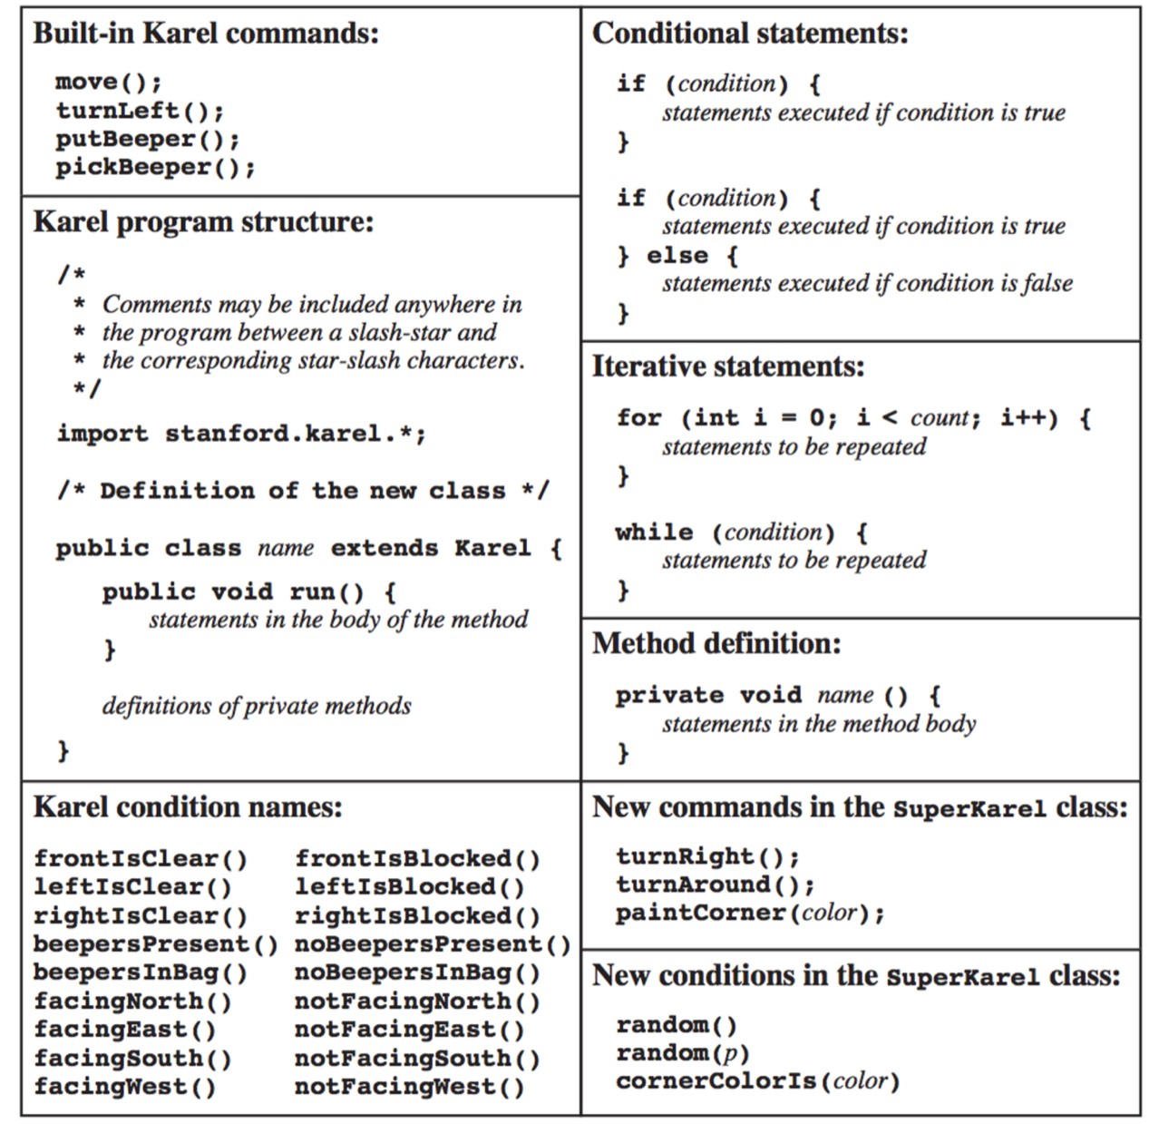
The Full Karel

Slide 142
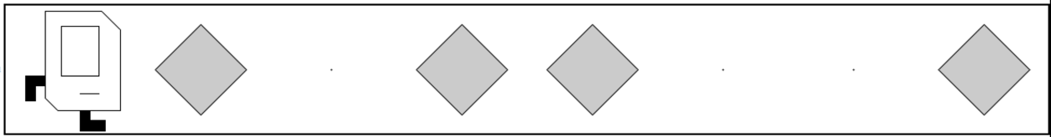
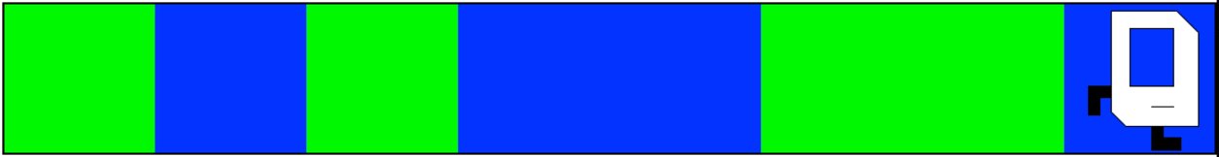
Random Painter
Before:
After:
Before:
After:

Slide 143
You just learned most of programming “control flow”

Slide 144
Today’s Goal
Code using loops and conditions
Trace programs that use loops and conditions

Slide 145
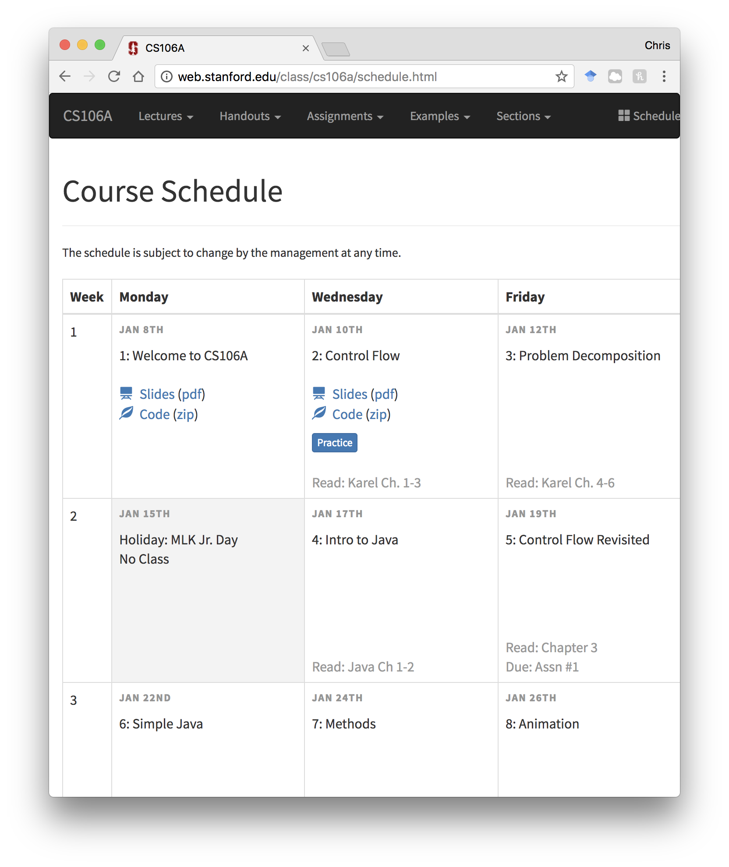
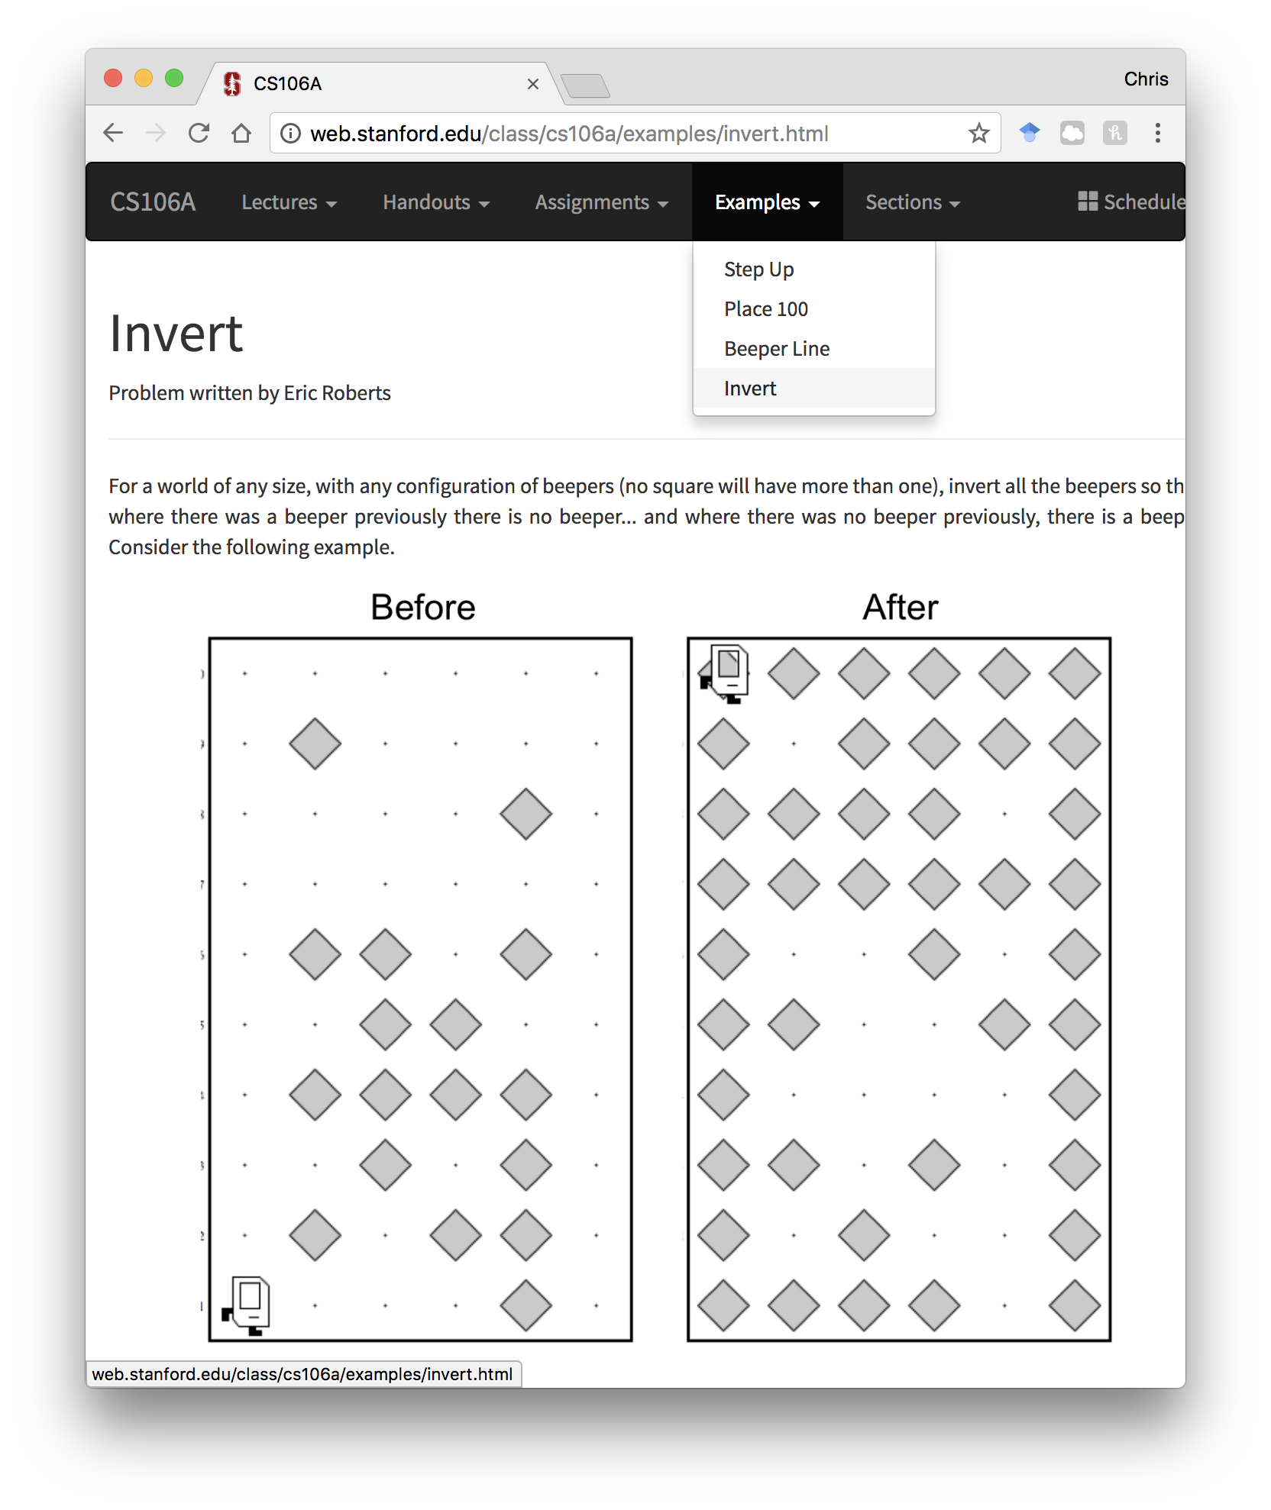
Examples and Practice

Slide 146
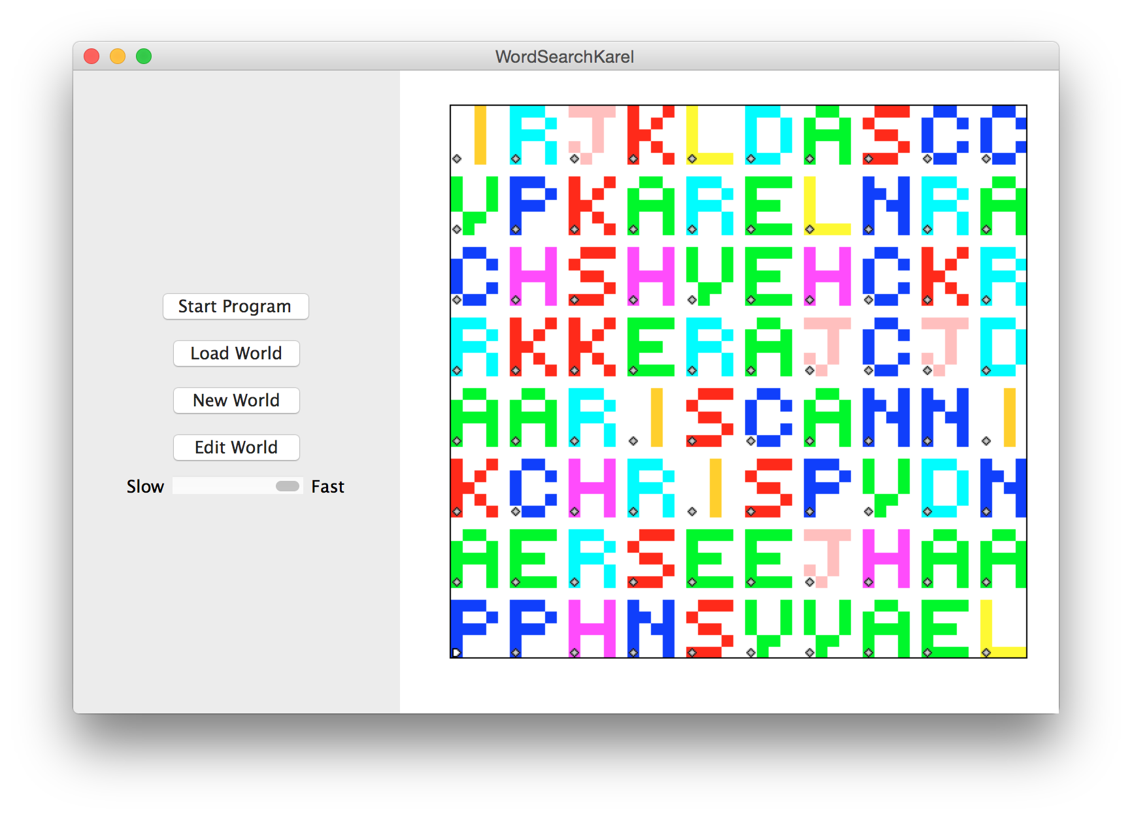

Slide 147
